Slide 1



Welcome to Mrs. Russell's second grade at
Tusky Valley Intermediate!

Slide 2
Standards based reporting
What does it mean and how can I help my child?

Slide 3
Standards Based Assessments
A standard is a specific goal that all students should be able to demonstrate upon exiting second grade.
We have aligned our curriculum to follow the standards given by the state of Ohio!
A standards based assessment allows you to gauge your child’s academic progress using a meaningful measure, the state standard. These assessments allow you to honestly know where your child’s academic strengths and weaknesses lie.
If my child performs poorly on an assessment in the first nine weeks will that score remain the same on the final report card?
NO! Students who score below a 3 on an assessment have the opportunity to be re-assessed on certain standards. Language Arts and Math standards will be the primary focus of re-assessments.

Slide 4
Standards Based Reporting…
“I can see the exact things that Billy needs extra work on. And, WOW! Look at all the things Billy knows and is doing well!”
Productive…
Parents see specific areas of success and weakness.
Learning goals can easily be targeted.
Parents can celebrate the areas of strength!

Slide 5
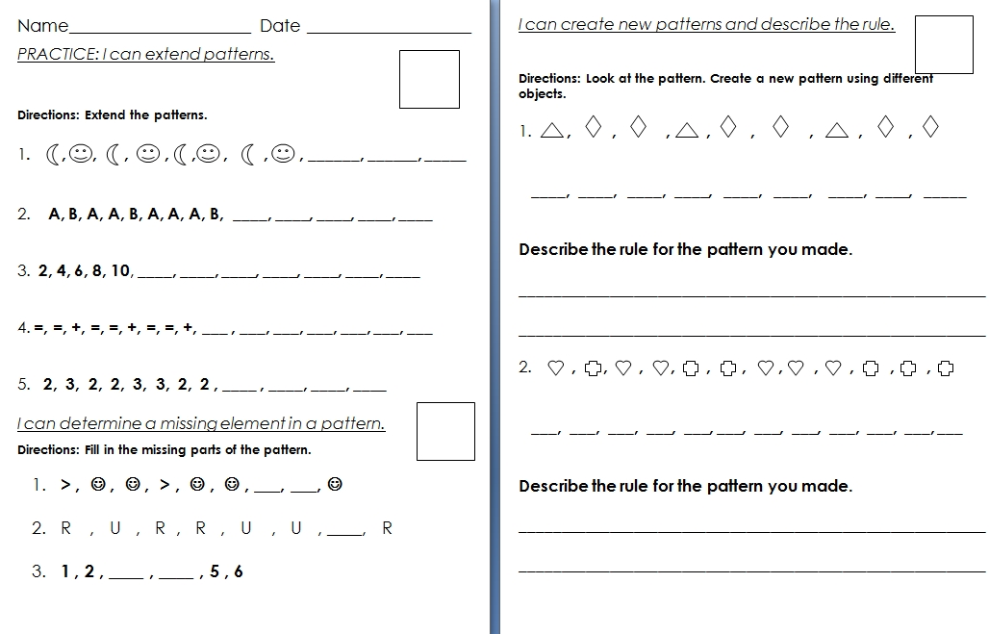
Assessment Example

Slide 6
How will I know how my child is doing?
Students receive a 3 when they meet the standard.
If they do not receive a 3, they may receive one of the following:
Students receive a 2 if they have made some progress but are not quite on track. Some intervention may be necessary.
Students receive a 1 if they require a lot of extra support and intervention to achieve the standard.

Slide 7
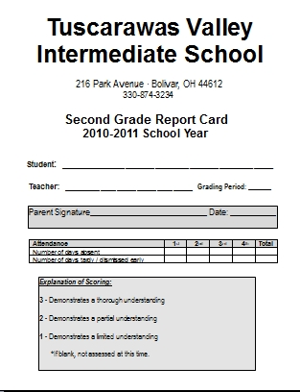
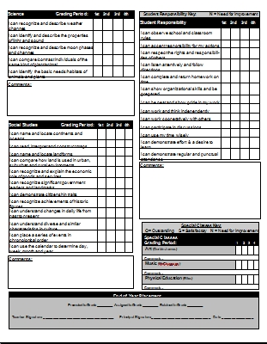
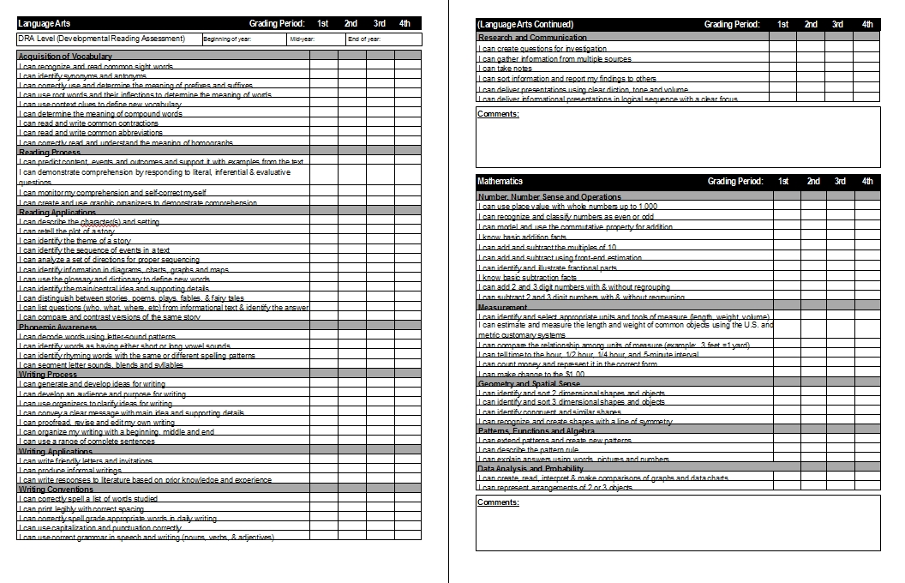
Our Standards Based Report Card

Slide 8
What does the standards based report card tell you as a parent?
It provides you with information on your child’s specific areas of progress toward the state standards each 9 week period.
The mid-term reports and report cards show your child’s strengths and weaknesses. As a parent you know where your child is excelling and where he/she needs additional assistance.

Slide 9
Data Notebook
The Data Notebook is designed to give parents and students the most current progress report available.
The Data Notebook is divided into areas similar to the report card. Assessments will remain in the Data Notebook for the grading period- possibly longer. Please do not remove anything!
This form of shared reporting permits parents and students to see strengths and weaknesses. Allowing parents to assist their child focus on needed areas.

Slide 10
Mrs. Russell’s Expectations…
Parents, please read the newsletter each week to stay current with class and school events. The newsletter will come home on Monday night with the Homework Log!
Please check your child’s Home Folder each night for important papers. We will have a weekly partner read that is to be read and signed at least three nights during the week.
Parents, please review the Data Notebook on Monday night WITH your child and sign and return it on Tuesday. Please initial each page you review! This will make it easier for you to check for NEW assessments each week.
Poetry Folders will come home on selected Fridays. Please follow the instructions with your child and sign the log.

Slide 11
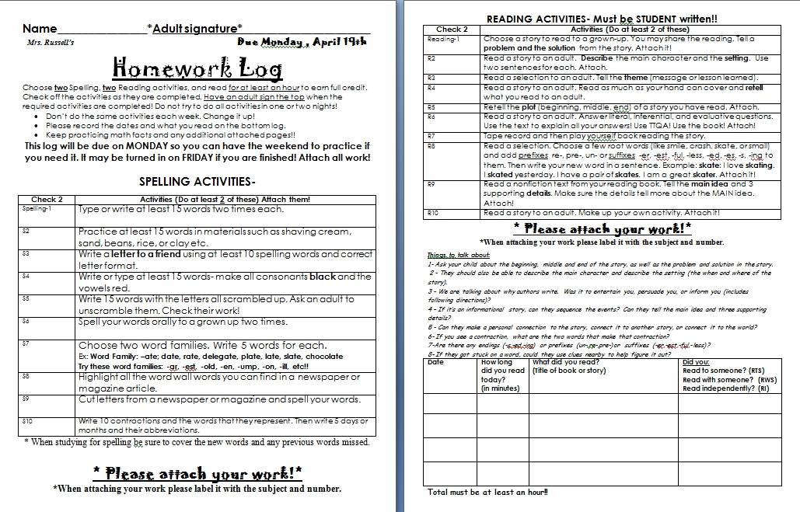
Homework Logs
Homework is to be completed by your child and checked by an adult each week. Homework logs will come home Monday night and are due on Friday. All work is to be attached.

Slide 12
How can I contact Mrs. Russell?
The fastest way to get in touch of me is through
e-mail. My address is: missy.russell@tvtrojans.org
If you do not have access to the internet you can always call the school- 874.3234

Slide 13
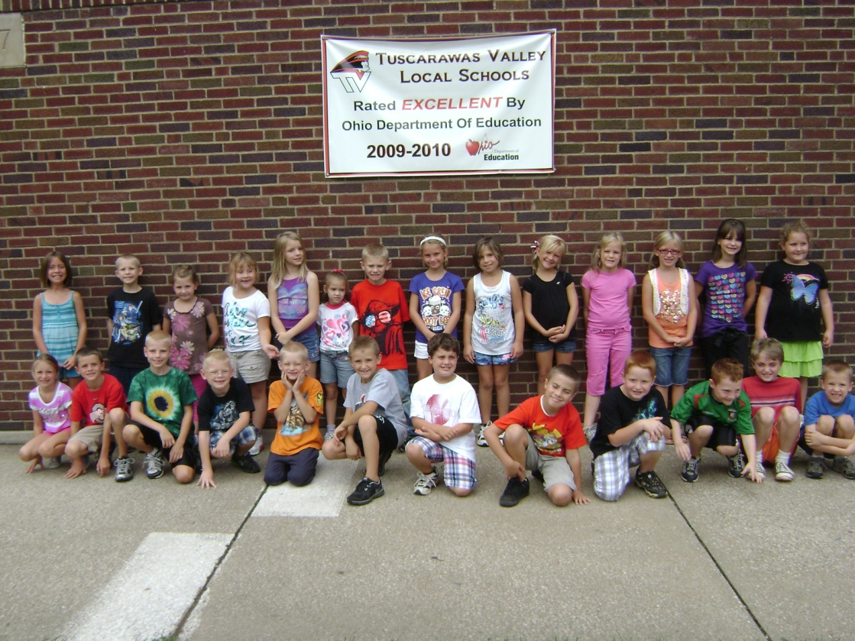
Book Orders…
Sharpeners…
Labeling Data Notebooks…
Spelling
Language Arts
Math Facts
Math
Content
(Science / Social Studies)

